Slide 1
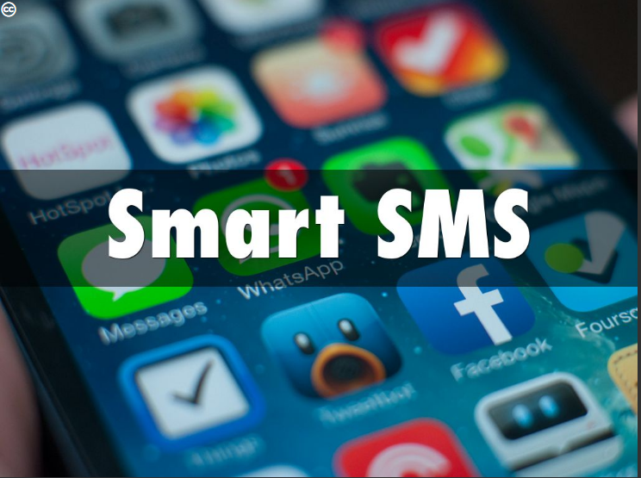

Slide 2
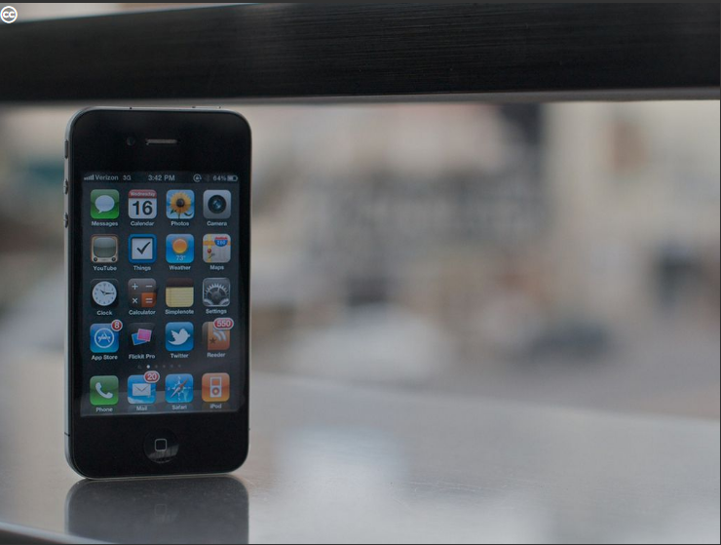
INTRODUCTION
The key is not to prioritize what is on your schedule, but to schedule your priorities.
Stephen Covey

Slide 3

INTRODUCTION
The use of mobile phone while driving or doing other activities has been found to be disastrous.
Using mobile phones can cause drivers to take their eyes off the road, their hands off the steering wheel and the surrounding situation.

Slide 4

Provide a convenient and Safer way to send messages by Scheduling Messages and reminders built on the IOS mobile platform.

Slide 5

User Interface
Background Mode
SMS Scheduler
SQLite Database

Slide 6

